Slide 1
A core Course on Modeling
Introduction to Modeling
0LAB0 0LBB0 0LCB0 0LDB0
c.w.a.m.v.overveld@tue.nl
v.a.j.borghuis@tue.nl
S.32

Slide 2
Reflection: iterate
define
formulate
purpose
Right problem?
(problem validation)
conceptualize
identify
entities
choose
relations
Right concepts?
(concepts validation)
formalize
obtain
values
formalize
relations
Right model?
(model verification)
execute
operate
model
obtain
result
Right outcome?
(outcome verification)
Right answer?
(answer verification)
conclude
present
result
interpret
result
Notes:
2

Slide 3
Criteria for modeling
Modeling is an iterative process
Models incrementally improve
To improve a model, compare 2 versions of a model
To compare, we need criteria
We introduced 8 criteria.
Notes:
3

Slide 4
Criteria for modeling
These criteria are:
genericity: how diverse can the modeled system be?
scalability: ‘how ‘large’ can the modeled system be?
specialization: with how little knowledge can the model be used?
audience: how many users can be served by the model?
convincingness: how plausible are the model assumptions?
dictinctiveness: how accurate/precise are the model results?
surprise: how much can we learn from the model?
impact: how much effect can the model results have?
Notes:
4

Slide 5
Criteria for modeling and purpose
Not each of the eight criteria is equally relevant for all purposes.
Given the purpose of the model, the modeler should identify the most relevant criteria to seek improvement when necessary.
http://cdn.morguefile.com/imageData/public/files/j/jusben/preview/fldr_2012_01_26/file381327572009.jpg
Notes:
5

Slide 6
Criteria for modeling and purpose
Not each of the eight criteria is equally relevant for all purposes.
prediction (1, 2):
convincingness, distinctiveness, impact
http://cdn.morguefile.com/imageData/public/files/c/clarita/preview/fldr_2005_02_25/file000537785623.jpg
Notes:
6

Slide 7
Criteria for modeling and purpose
Not each of the eight criteria is equally relevant for all purposes.
compression:
scalability, audience, distinctiveness
http://cdn.morguefile.com/imageData/public/files/m/manicmorff/preview/fldr_2010_08_06/file1241281130580.jpg
Notes:
7

Slide 8
Criteria for modeling and purpose
Not each of the eight criteria is equally relevant for all purposes.
inspiration:
surprise
http://cdn.morguefile.com/imageData/public/files/g/grietgriet/preview/fldr_2010_06_10/file6221276174321.jpg
Notes:
8

Slide 9
Criteria for modeling and purpose
Not each of the eight criteria is equally relevant for all purposes.
unification:
genericity, convincingness, surprise
http://cdn.morguefile.com/imageData/public/files/m/mzacha/preview/fldr_2008_11_28/file000562242221.jpg
Notes:
9

Slide 10
Criteria for modeling and purpose
Not each of the eight criteria is equally relevant for all purposes.
abstraction:
distinctiveness, convincingness, surprise
http://www.morguefile.com/archive/display/194953
Notes:
10

Slide 11
Criteria for modeling and purpose
Not each of the eight criteria is equally relevant for all purposes.
verification:
scalability, convincingness, impact
http://cdn.morguefile.com/imageData/public/files/m/mconnors/preview/fldr_2003_01_31/file0001885959031.jpg
Notes:
11

Slide 12
Criteria for modeling and purpose
Not each of the eight criteria is equally relevant for all purposes.
exploration:
genericity, surprise
http://www.morguefile.com/archive/display/186546
Notes:
12

Slide 13
Criteria for modeling and purpose
Not each of the eight criteria is equally relevant for all purposes.
decision:
QUIZ
Perhaps you should try yourself first:
what criteria would you consider most important for a model that should help making a decision?
http://cdn.morguefile.com/imageData/public/files/p/pippalou/03/l/13634795461edmu.jpg
Notes:
13

Slide 14
Criteria for modeling and purpose
Not each of the eight criteria is equally relevant for all purposes.
decision:
convincingness, distinctiveness, impact
http://cdn.morguefile.com/imageData/public/files/p/pippalou/03/l/13634795461edmu.jpg
Notes:
14

Slide 15
Criteria for modeling and purpose
Not each of the eight criteria is equally relevant for all purposes.
optimization:
genericity, scalability, convincingness, impact
http://www.morguefile.com/archive/display/108487
Notes:
15

Slide 16
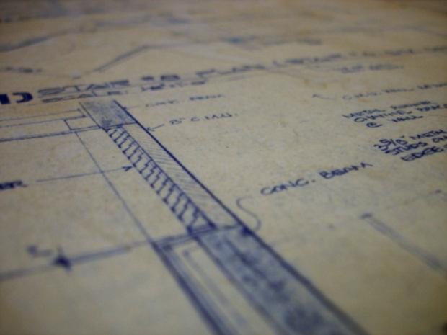
Criteria for modeling and purpose
Not each of the eight criteria is equally relevant for all purposes.
specification:
genericity, distinctiveness
http://www.morguefile.com/archive/display/129150
Notes:
16

Slide 17
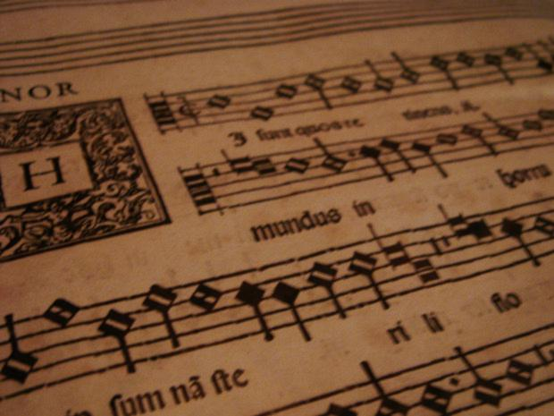
Criteria for modeling and purpose
Not each of the eight criteria is equally relevant for all purposes.
realization:
genericity, distinctiveness, impact
http://cdn.morguefile.com/imageData/public/files/c/clarita/preview/fldr_2004_10_15/file000675840112.jpg
Notes:
17

Slide 18
Criteria for modeling and purpose
Not each of the eight criteria is equally relevant for all purposes.
steering & control:
distinctiveness
http://www.morguefile.com/archive/display/213101
Notes:
18

Slide 19
Criteria for modeling and purpose
Realize that these criteria are mainly
rules of thumb.
In every concrete case, judge for
yourself what improvement is best
for the purpose at hand.
http://www.morguefile.com/archive/display/213101
http://cdn.morguefile.com/imageData/public/files/p/pixe07/preview/fldr_2009_10_16/file1691255717296.jpg
Notes:
19

